Slide 1
Containers and DevOps
Dan Shue
Azure App Dev Architect
danshue@microsoft.com

Slide 2
Agenda
Introduction
Whiteboard Design Session (120 min)
Infrastructure Setup (60 min)
Lunch (60 min) ~ 12:00 PM
Hands-on Labs (240 min) ~ 1:00 PM to 4:00 PM
Closing (15 min) ~ 4:15 PM

Slide 3

Abstract and learning objectives
Abstract
This whiteboard design session is designed to help attendees understand the choices related to building and deploying containerized applications in Azure, critical decisions around this and other aspects of the solution including ways to lift-and-shift parts of the application to reduce applications changes.
Learning objectives
Work with Docker images and Azure Container Registry
Create a Kubernetes cluster with Azure Kubernetes Service (AKS)
Deploy containers to a Kubernetes cluster
Load balance containers, set up dynamic service discovery
Scale services
Perform rolling upgrades with zero downtime

Slide 4
Whiteboard Design Session
https://aka.ms/danshue-container-devops
Step 1: Review customer case study – (15 min)
Step 2: Design POC – (60 min)
Step 3: Present the solution – (30 min)

Slide 5
Step 1: Review the customer case study
Outcome
Analyze your customer needs
Timeframe
15 minutes

Slide 6
Customer situation
Fabrikam Medical Conferences provides conference web site services tailored to the medical community
After starting with a few small conferences, they now have evolved into a well-known brand and handle over 100 conferences per year, and growing

Slide 7
Customer situation
Each conference site has limited budget, but the conference owners have significant customization and change demands
These changes can impact various aspects of the system from UI to back end, including conference registration and payment terms

Slide 8
Customer situation
12 developers handle
Development
Testing
Deployment
Operational management of all customer sites
Due to customer demands, they have issues with the efficiency and reliability of their development and DevOps workflows

Slide 9
Customer situation
The technology used is the MEAN stack
Mongo, Express, Angular, and Node.js
Conference sites are currently hosted on Windows Server machines on premise
The data back-end is a MongoDB cluster also deployed to Windows Server machines on premise

Slide 10
Customer situation
Conference owners (“customers”) are considered “tenants”, and each tenant is treated as a unique deployment including:
A database in the MongoDB cluster with its own collections
A copy of the most recent functional conference code base is taken and configured to point at the tenant database
Modifications are made to support the customer’s needs
The tenant’s code is deployed to a specific group of load balanced Windows Server machines dedicated to one or more tenant
Once the conference site is live, the inevitable requests for customizations to the deployment begins

Slide 11

Customer situation
They are looking to achieve the following:
Reduce potential regressions introduced to functional tenant code when changes are made
Ideally, changes to individual areas should not require a full regression test of the site functionality
Reduce the time to onboard new tenants
Reduce overhead managing changes, and related deployments
Improve ability to roll back and recover post change
Increase visibility into system operations and health

Slide 12
Customer needs
Simplify new tenant deployment
Improve reliability of tenant updates
Choose a suitable Docker container strategy on Azure
Migrate MongoDB data to Cosmos DB without application changes
Continue to use Git repositories for source control
Look at Azure DevOps as the CICD tool of choice
Use tools for deployment, CICD integration, container scheduling, orchestration, monitoring, and alerts
They wish to complete an implementation of the proposed solution for a single tenant to train the team and perfect the process

Slide 13

Customer objections
There are many ways to deploy Docker containers on Azure, how do those options compare and what are motivations for each?
Is there a PaaS option in Azure that also provides the full container orchestration platform options, that would be easy to migrate to but also handle our scale and management requirements?

Slide 14
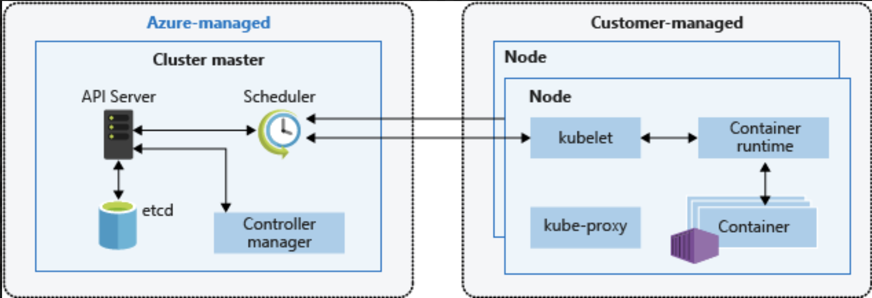
Common scenarios
Kubernetes Architecture

Slide 15
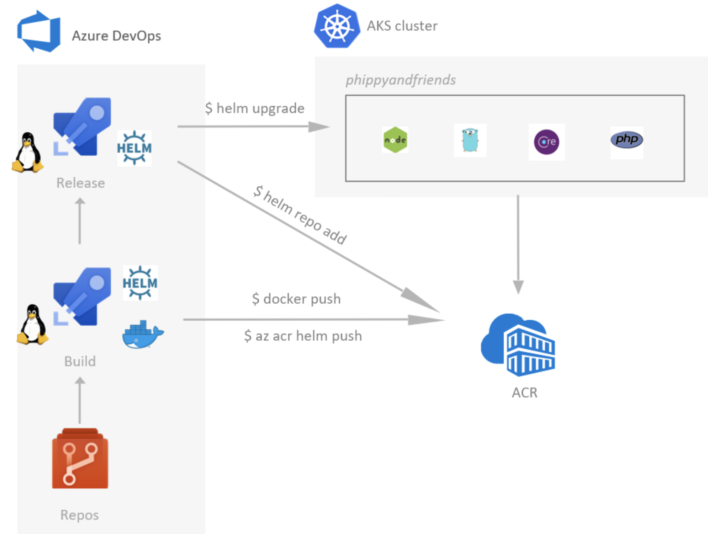
Common scenarios
Azure DevOps for CICD to Azure Kubernetes Service (AKS)

Slide 16
Step 2: Design the solution
Outcome
Design a solution and prepare to present the solution to the target customer audience in a 15-minute chalk-talk format.
Timeframe
60 minutes
Business needs (10 minutes) | Respond to questions outlined in your guide and list the answers on a flipchart.
Design (35 minutes) | Design a solution for as many of the stated requirements as time allows. Show the solution on a flipchart.
Prepare (15 minutes) | Identify any customer needs that are not addressed with the proposed solution. Identify the benefits of your solution. Determine how you will respond to the customer’s objections. Prepare for a 15-minute presentation to the customer.

Slide 17
Step 3: Present the solution
Outcome
Prepare to present a solution to the target customer in a 15-minute chalk-talk format
Timeframe
30 minutes (15 minutes for each team to present and receive feedback)
Directions
Pair with another table
One table is the Microsoft team and the other table is the customer
The Microsoft team presents their proposed solution to the customer
The customer asks one of the objections from the list of objections in the case study
The Microsoft team responds to the objection
The customer team gives feedback to the Microsoft team

Slide 18
Wrap-up
Outcome
Identify the preferred solution for the case study
Identify solutions designed by other teams
Timeframe
15 minutes

Slide 19

Preferred target audience
Arthur Block, VP Engineering at Fabrikam Medical Conferences
The primary audience is the technical strategic decision-maker with influential solution architects, or lead technical personnel in development or operations
Usually we talk to the key architects, developers and infrastructure managers who report to the CIO or equivalent, or to key solution sponsors or those that represent the business unit IT or developers that report to those sponsors
Notes:
The primary audience is the technical strategic decision-maker with influential solution architects, or lead technical personnel in development or operations.
For this example this could include the VP Engineering and his core team.

Slide 20
Preferred solution
After evaluating the options for container platforms on Azure, Fabrikam Medical Conferences decided to move forward with Azure Kubernetes Service (AKS)
They also decided to move forward with Azure DevOps for infrastructure and container DevOps workflows

Slide 21
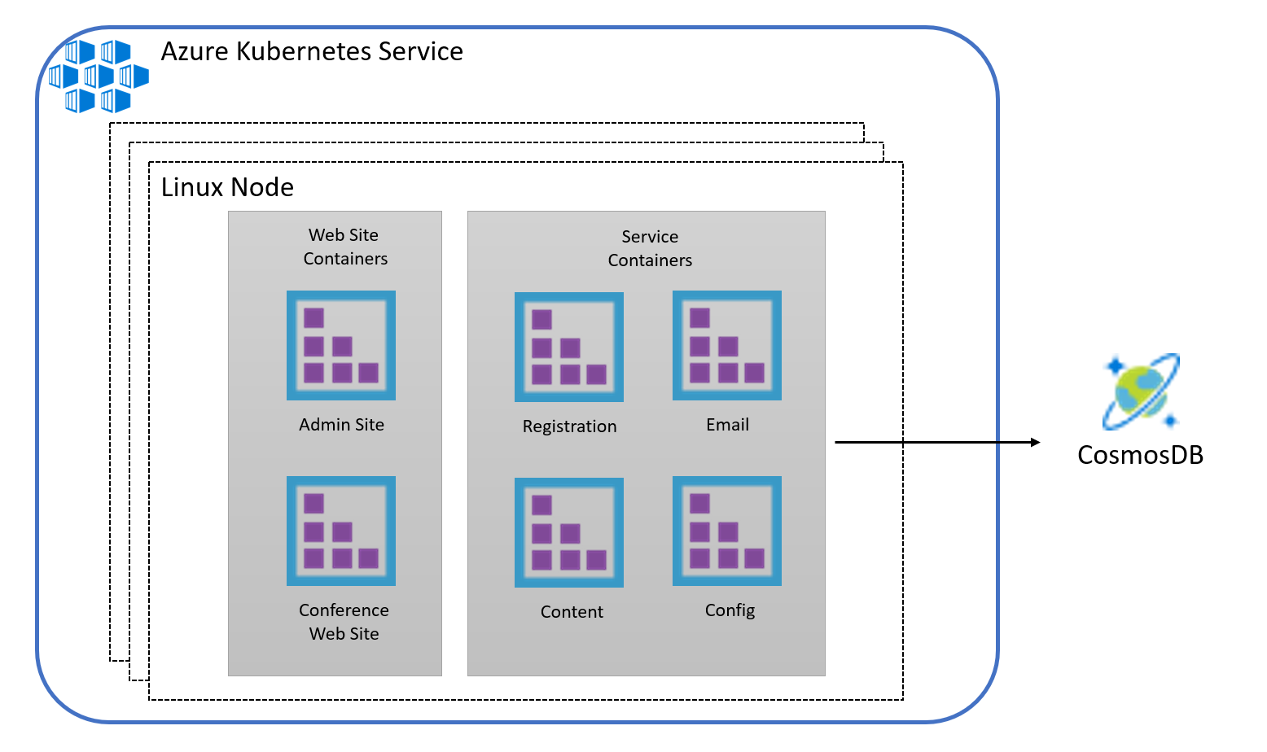
Preferred solution

Slide 22
Preferred objections handling
With so many platforms and tools for Docker and container orchestration, how should we choose an option for Azure?
App Service for Containers – simple, PaaS without robust orchestration platform management tooling
Azure Container Instances – simple, isolated, without management tooling
Azure Kubernetes Services (AKS) – the ideal solution for a fully managed experience
Notes:
The easiest way to move to containers on Azure is to deploy containers to App Service for Containers, however, this option does not provide the typical management tools for container orchestration – that can provide load balancing, dynamic discovery, self-healing, and a holistic approach to container monitoring.
Azure Container Instances also provide a simple way to manage individual containers without management tooling.
Ideally, Azure Kubernetes Service (AKS) will provide a fully managed service with the full set of orchestration and management tools – as it evolves. Working with AKS is the best choice to enable migration to AKS while still benefiting from a complete container orchestration experience to support the growth trajectory of the solution.

Slide 23
Preferred objections handling
What is the simplest way to move to containers on Azure, based on our PaaS experience, while at the same time considering our scale and growth requirements?
The best option is to go with a managed cluster such as Azure Container Service (AKS), native to Azure
Notes:
The best of all worlds is to go with a managed orchestration platform like AKS – native to Azure. It reduces the cost and management overhead of the cluster, while still providing a solution that supports growth, scale, and native management tooling.
With Kubernetes you will have additional features at your fingertips beyond the pure Docker approach including:
The Kubernetes management dashboard which includes web interface and remote APIs for managing, running, and scaling containers, including CICD integration options.
The kubectl command line tool for engaging remote Kubernetes APIs and assisting with automation.
Built-in dynamic service discovery simplifying the deployment of new container instances to a load balanced environment.

Slide 24
Customer quote
“With Azure Kubernetes Service (AKS) we feel confident we can make the move to a container-based platform with the right DevOps support in place to be successful with a small team.”
- Arthur Block, VP of Engineering at Fabrikam Medical Conferences

Slide 25
Infrastructure Setup
Azure Subscription
Trial Subscription will not work
Azure Pass Available (West US Only Deployment)
Azure DevOps Account (Free!)
Create new using same login as Azure Subscription
Development Machine
Create a build agent VM
Create a Azure Container Registry
Create a Azure Kubernetes Service Cluster
Install Azure CLI, Kubernetes CLI, Install Helm
Setup Repo

Slide 26
References
Microsoft Cloud Workshop
http://microsoftcloudworkshop.com/

